Slide 1

Sinhgad Technical Education Society RMD Sinhgad Technical Institute Campus Warje, Pune
Academic year: 2024-25
Final Year Project
On
PHYSIOTHERAPY POSE DETECTION
Presented by:
Atharv Chormale B401020286
Jay Patil B401020303
Chaitanya Pathak B401020327
Under the Guidance of – Mrs. Jaitee Bankar

Slide 2
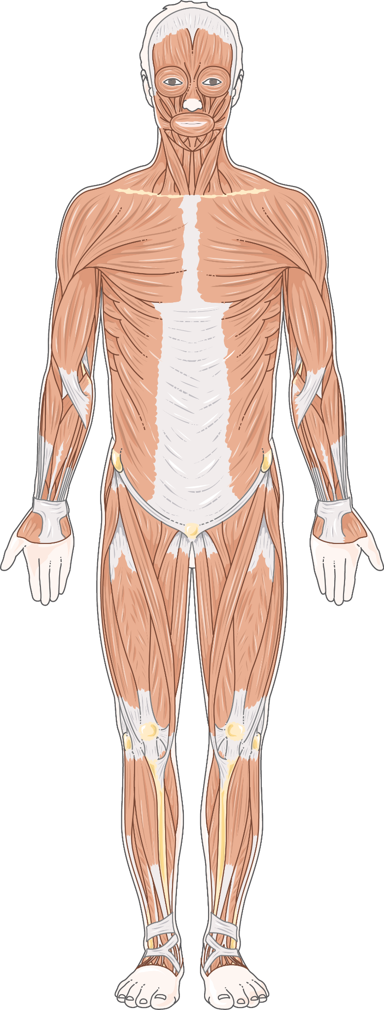
INTRODUCTION
The physiotherapy pose detection model uses computer vision and deep learning to support accurate physiotherapy exercises. By analyzing body posture and movement in real-time via a standard PC camera, it offers feedback to ensure correct form, essential for rehabilitation. Using pose estimation algorithms like OpenPose, the system assesses key body points to help prevent injury and enhance therapeutic results. This tool provides accessible, private, home-based support for physiotherapy, enabling effective self-guided rehabilitation and improving recovery outcomes.

Slide 3
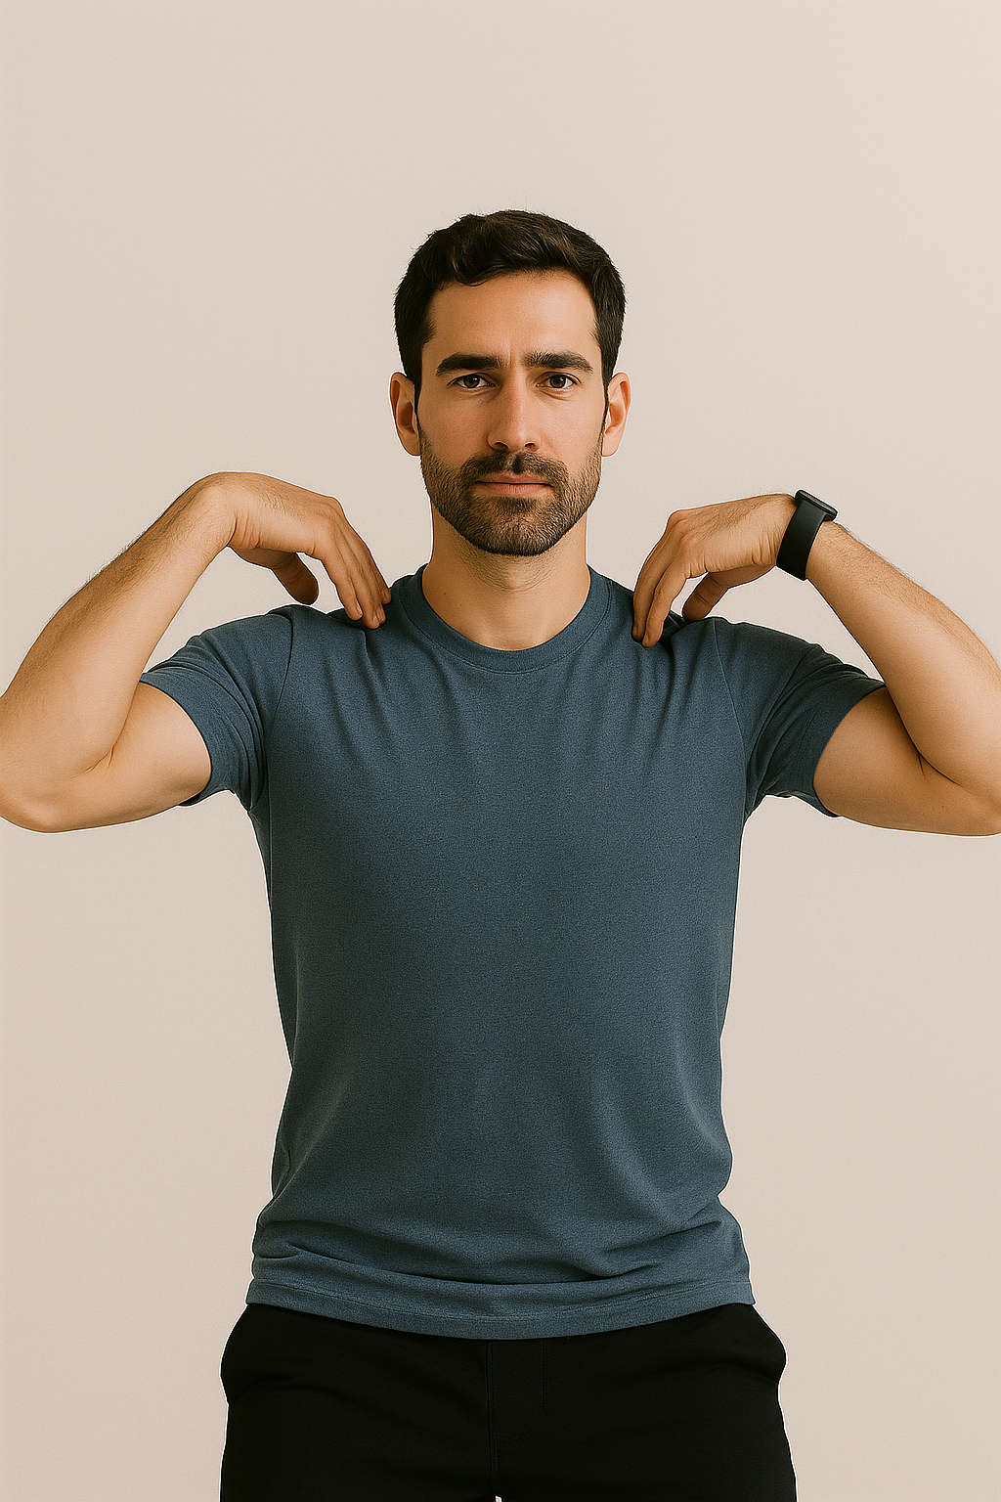
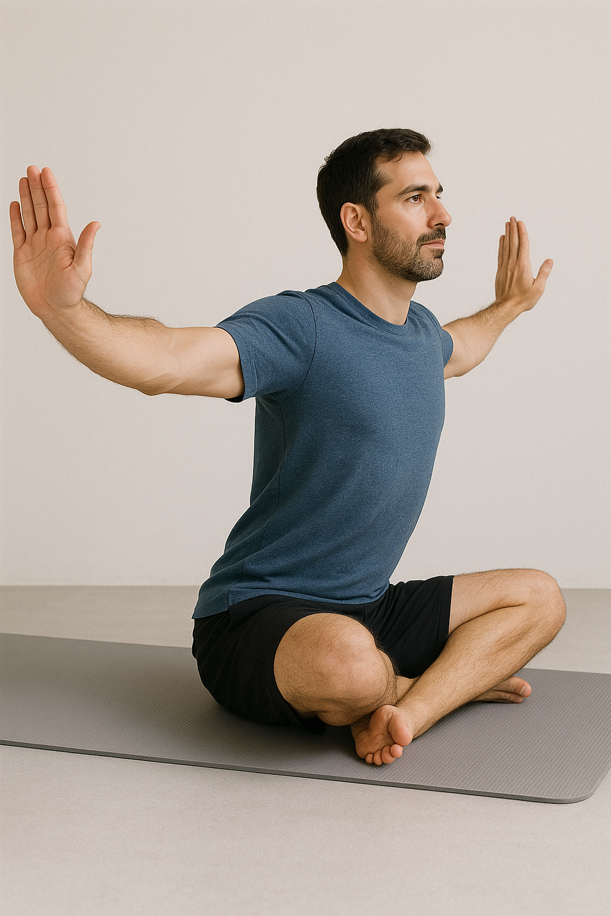
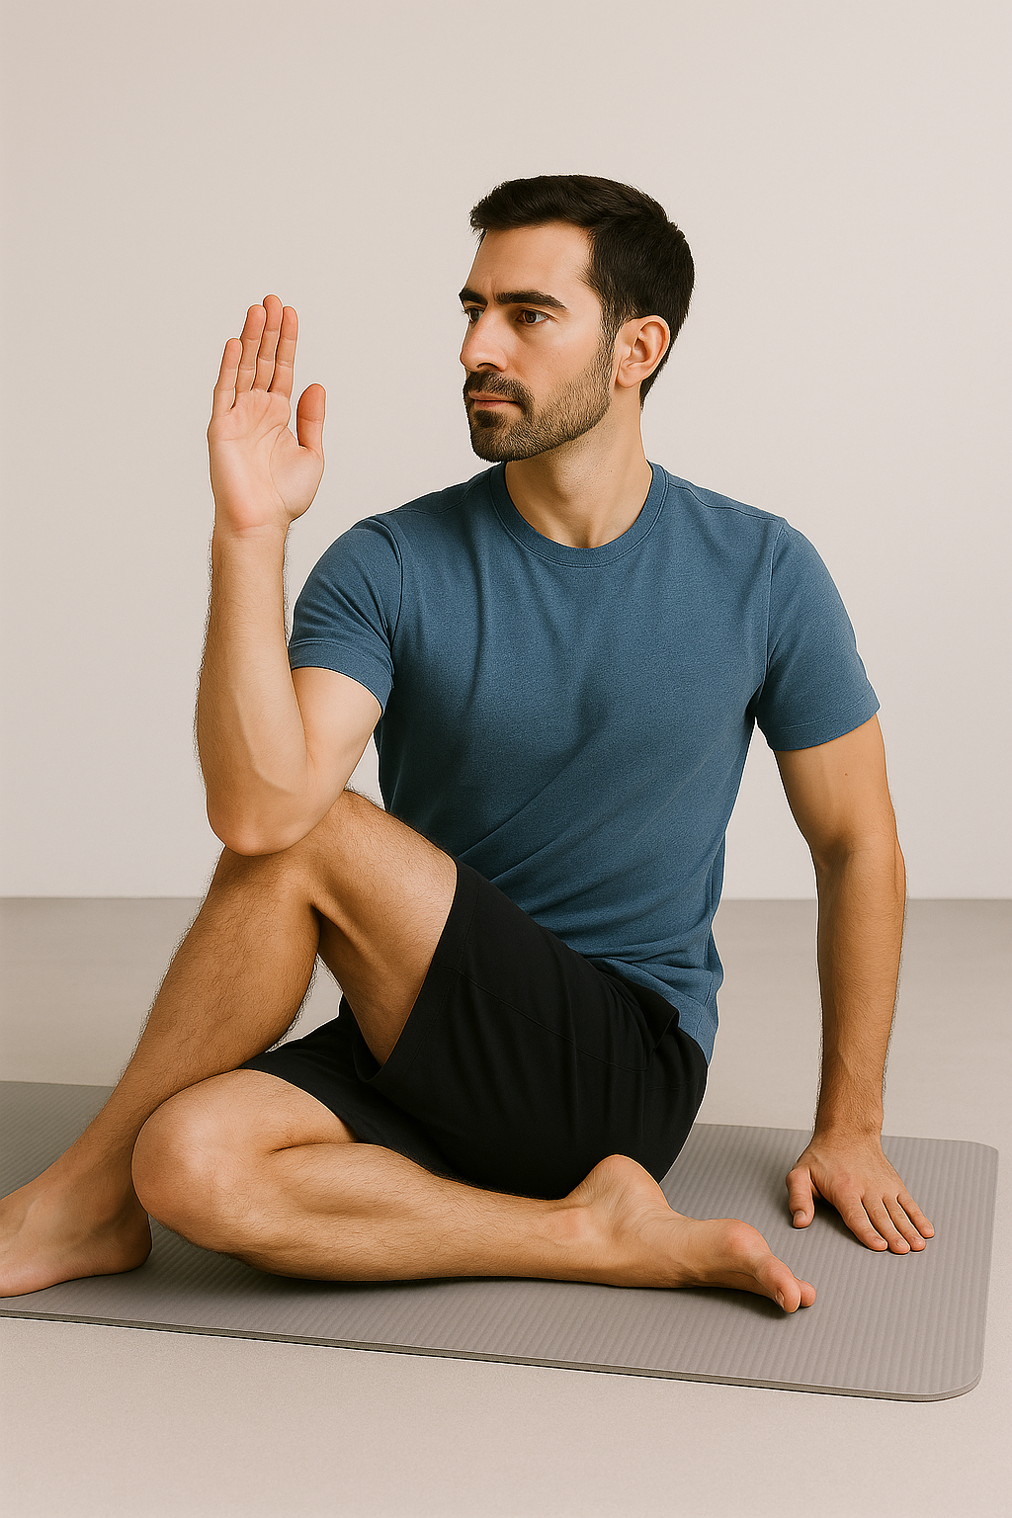
PYSIOTHERAPY POSES
A. Shoulder Rotations
B. Arm Rotation
C. Spinal Twist

Slide 4
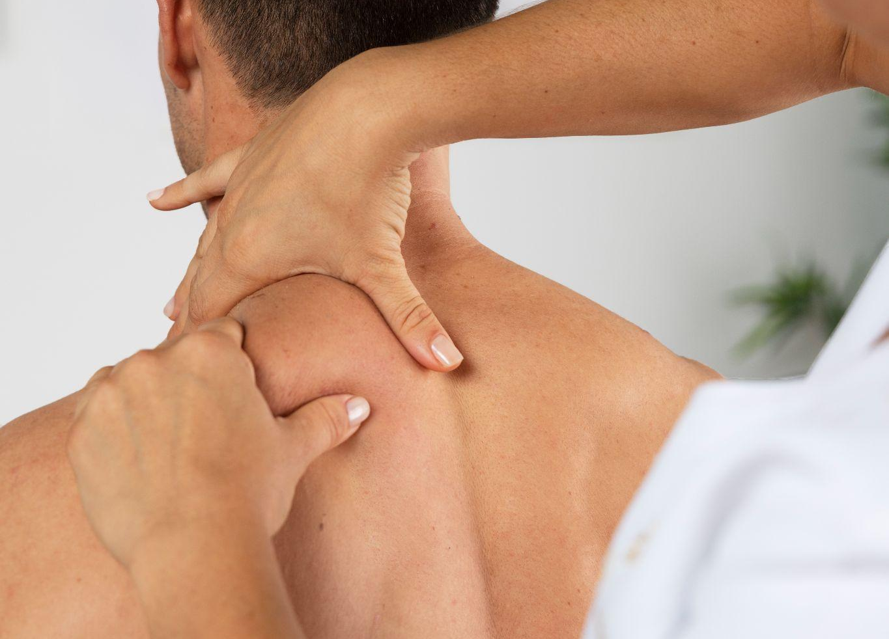
MOTIVATION
Human pose estimation is a challenging problem in the discipline of computer vision.
To automatically detect a person’s pose in an image is a difficult task as it de pends on a number of aspects such as scale and resolution of the image, illumination variation, background clutter, clothing variations, surroundings, and interaction of humans with the surroundings.

Slide 5
OBJECTIVE
01
Promoting self-awareness and breath control.
05
Offering remote access with real-time corrective feedback.
Supporting deep relaxation for mental and emotional well-being.
02
06
Tracking progress to help users monitor and improve their performance over time.
04
Improving overall health by challenging both mind and body.
03
Strengthening the mind-body connection through guided poses.

Slide 6
PROBLEM STATEMENT
The system uses a PC camera to detect body poses, compares user poses with an instructor’s, and suggests corrections when deviations exceed a set threshold. This approach allows users to practice physiotherapy remotely.
ㅤㅤㅤ

Slide 7
LITREATURE SURVEY
Title | Publication | Author | Abstract
1. Real-time Recognition of Yoga Poses using computer Vision for Smart Health Care (2022) | https://arxiv.org/abs/2201.07594 | Abhishek Sharma, Yash Shah, Yash Agrawal, Prateek Jain | This study introduces a self-assistance yoga posture identification technique for real-time correction during practice, including the identification of yoga hand mudras. A dedicated YOGI dataset was created, comprising images of 10 yoga poses (400–900 images each) and 5 mudras (500 images each). Pose and mudra features are extracted by overlaying skeletal structures on body and hand images. Joint angles serve as features for machine learning and deep learning models, with XGBoost using RandomSearch CV achieving the highest accuracy of 99.2%. The framework's complete design is presented in this work.
ㅤㅤㅤ

Slide 8
LITREATURE SURVEY
Title | Publication | Author | Abstract
2. A New Dataset for Fine-grained Classification of Human Poses (2020) | https://arxiv.org/abs/2004.10362 | Manisha Verma, Sudhakar Kumawat, Yuta Nakashima, Shanmuganathan Raman | This research addresses the limitations of existing pose estimation datasets in handling diverse poses, object occlusion, and varied viewpoints. To improve on this, we propose a fine-grained hierarchical pose classification method, reformulating pose estimation as a classification task. We introduce Yoga-82, a large-scale dataset featuring 82 distinct yoga poses with complex annotations, organized in a three-level hierarchy: general body positions, variations, and specific pose names. Classification accuracy is evaluated using state-of-the-art CNN architectures, and we present hierarchical DenseNet variants to leverage the structured labels effectively.
ㅤㅤㅤ

Slide 9
LITREATURE SURVEY
Title | Publication | Author | Abstract
3. Recognition Of Yoga Poses Using EMG Signals From Lower Limb Muscle (2019) | https://ieeexplore.ieee.org/abstract/document/8692300 | Pradchaya Anantamek; Narit Hnoohom | This study investigates a yoga posture recognition system to assess the accuracy of lower-limb movements during yoga practice. Using Electromyography (EMG) signals, data from four lower-limb muscles were collected from ten subjects performing five yoga postures. Three machine learning algorithms were applied to recognize postures, with the Random Forest Decision Tree achieving the highest accuracy at 87.43%, highlighting its effectiveness in identifying posture correctness.
ㅤㅤㅤ

Slide 10
LITREATURE SURVEY
Title | Publication | Author | Abstract
4. Learning distributions of transformations from small datasets for applied image synthesis. (2020) | https://dspace.mit.edu/handle/1721.1/128342 | Guha Balakrishnan, Amy Zhao | This thesis investigates image synthesis techniques using small datasets, focusing on two key applications. First, it presents a novel data augmentation method that generates realistic, diverse training examples to improve few-shot object classification and enables effective medical image segmentation with limited labeled data. Second, it introduces a method for synthesizing time-lapse videos of digital and watercolor paintings, using a recurrent model to create plausible visual stories of the painting process. Together, these methods enhance machine learning performance in settings with limited data and open new possibilities in image synthesis applications.
ㅤㅤㅤ

Slide 11
LITREATURE SURVEY
Title | Publication | Author | Abstract
5. Novel IoT-Based Privacy-Preserving Yoga Posture Recognition System Using Low-Resolution Infrared Sensors and Deep Learning. (2018) | https://ieeexplore.ieee.org/document/8707064 | Munkhjargal Gochoo, Tan-Hsu Tan. | Addressing privacy concerns in physiotherapy applications, this study introduces an IoT-based system that utilizes low-resolution infrared sensors instead of video to capture patient postures. Using deep learning algorithms, the system achieves an F1-score of 0.9989, indicating high accuracy in posture recognition without compromising privacy. Despite strong performance, limitations include dependency on Wi-Fi and sensor resolution, which could affect accuracy in variable home environments. The study provides a scalable solution for privacy-preserving posture recognition, specifically tailored for at-home physiotherapy.
ㅤㅤㅤ

Slide 12
LITREATURE SURVEY
Title | Publication | Author | Abstract
6. Implementation of Computer Vision in Detecting Human Poses (2020) | https://ieeexplore.ieee.org/document/9211145 | I. Gregory and S. M. Tedjojuwono. | This study highlights the importance of core muscle development in children to enhance their physical activity abilities. Conducted within an educational organization, the research involved certified trainers using yoga-like poses to strengthen children’s cores. To address inconsistencies in trainer judgment, a computerized pose detection system was developed, enabling trainers to standardize and assess student poses more accurately. While the system showed promising results, some unique poses led to unidentified outcomes, suggesting room for improvement in pose detection accuracy.
ㅤㅤㅤ

Slide 13
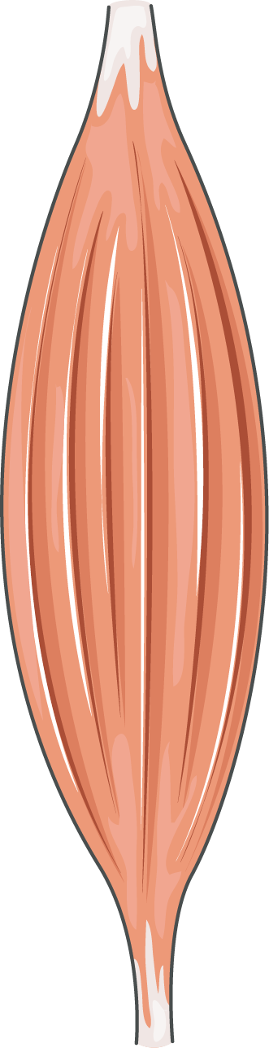
SYSTEM REQUIREMENTS SPECIFICATION
Software requirements
IDE: Spyder
Coding Language: Python Version 3.8
Operating System: Windows 10(64 Bit) 3.5.3
Database: SQLite
Hardware requirements
RAM: 8 GB Processor: Intel i5 Processor
Speed: 1.1 GHz
Hard Disk: 40 GB
Key Board: Standard Windows

Slide 14

INTERFACE

Slide 15
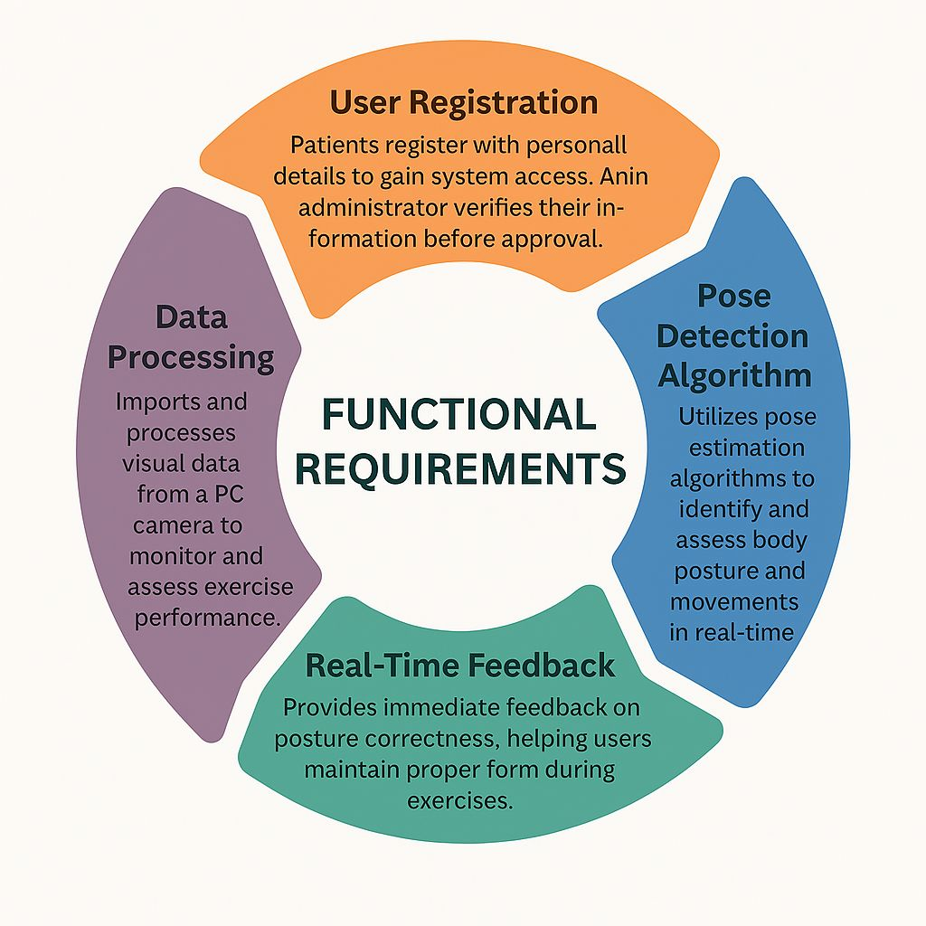
ㅤㅤㅤ

Slide 16
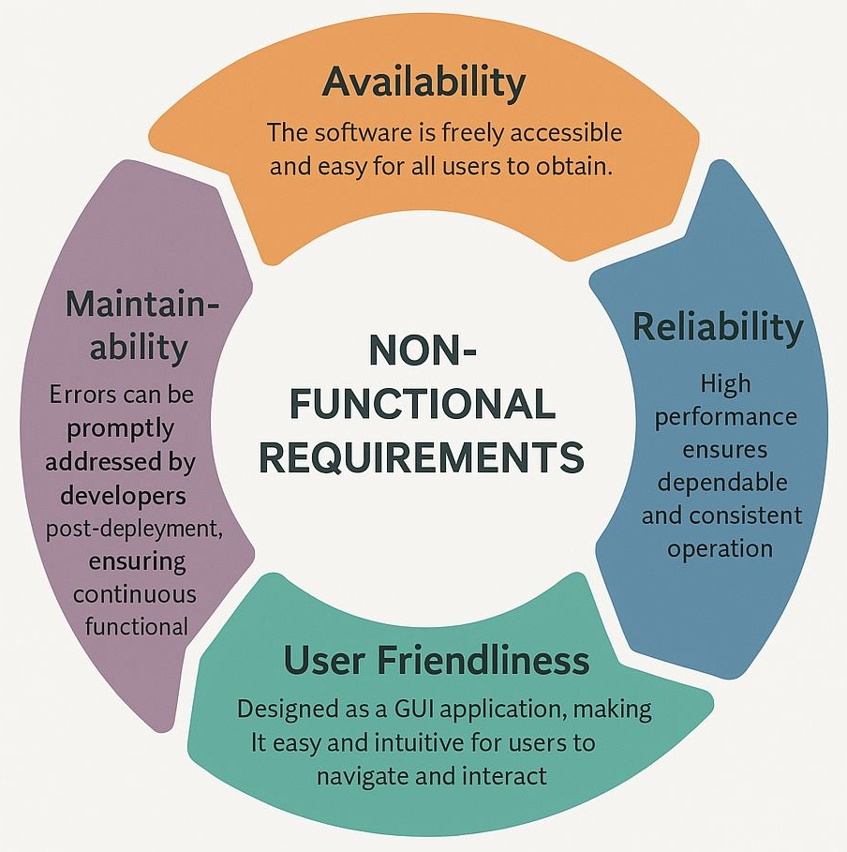
ㅤㅤㅤ

Slide 17
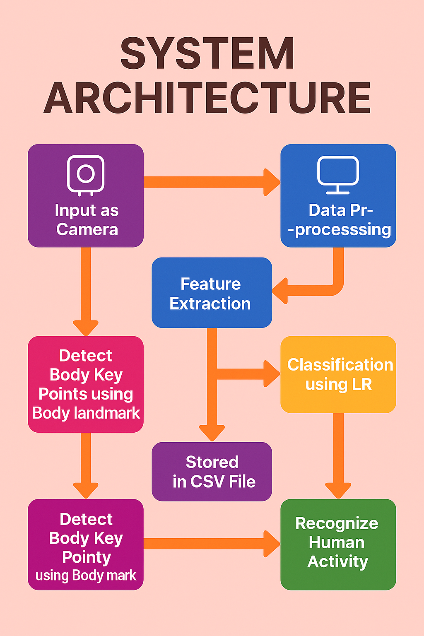

Slide 18
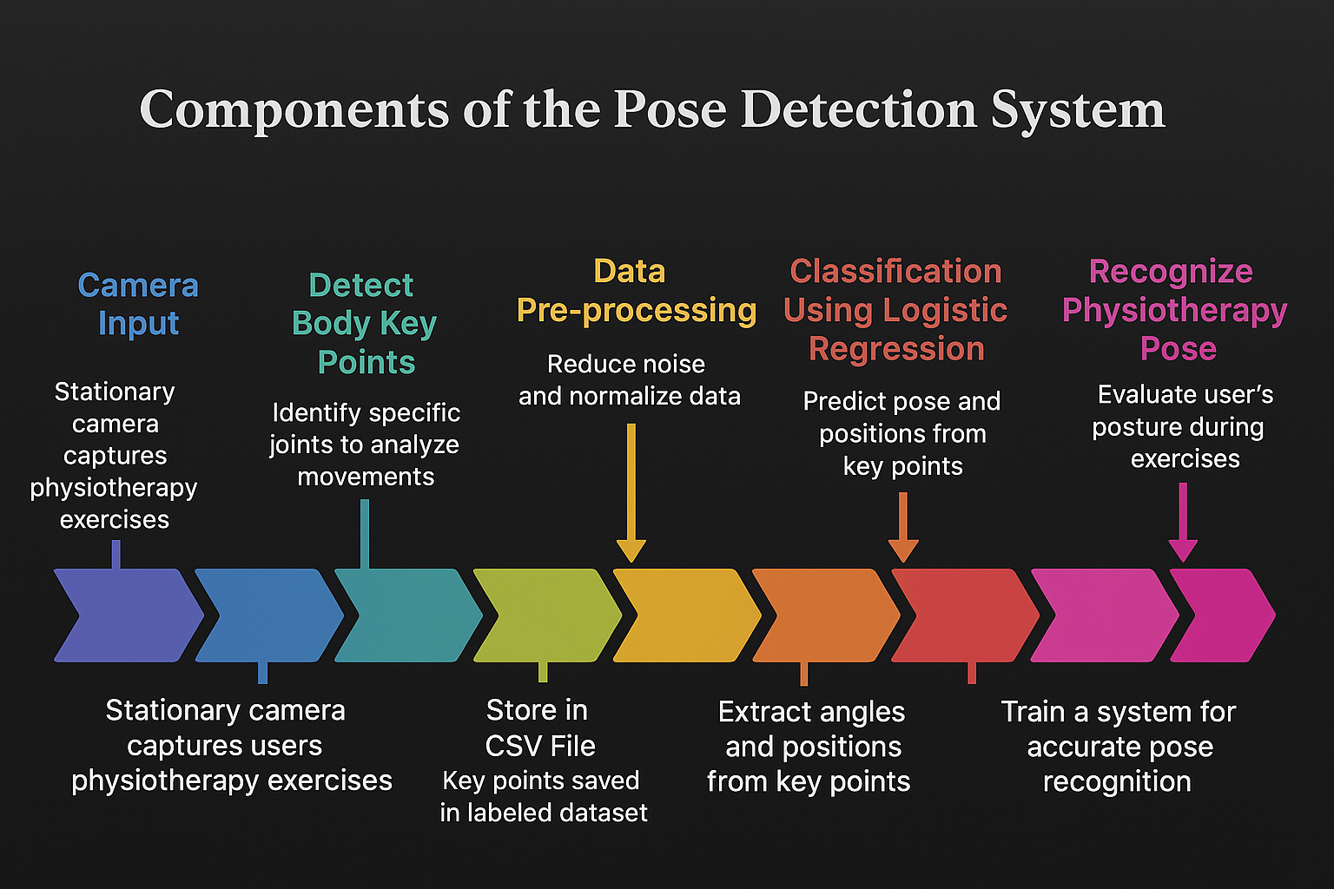
ㅤㅤㅤ

Slide 19

DFD
Level 0

Slide 20
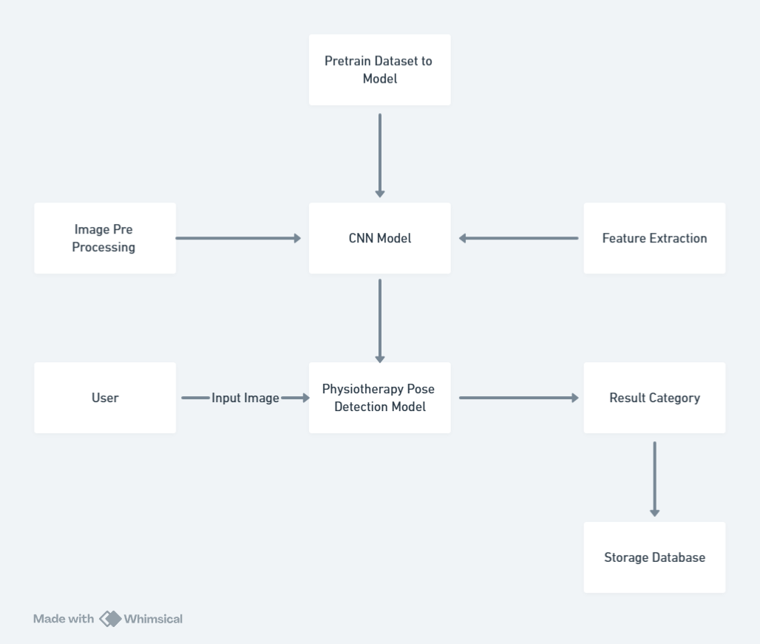
DFD
Level 1

Slide 21
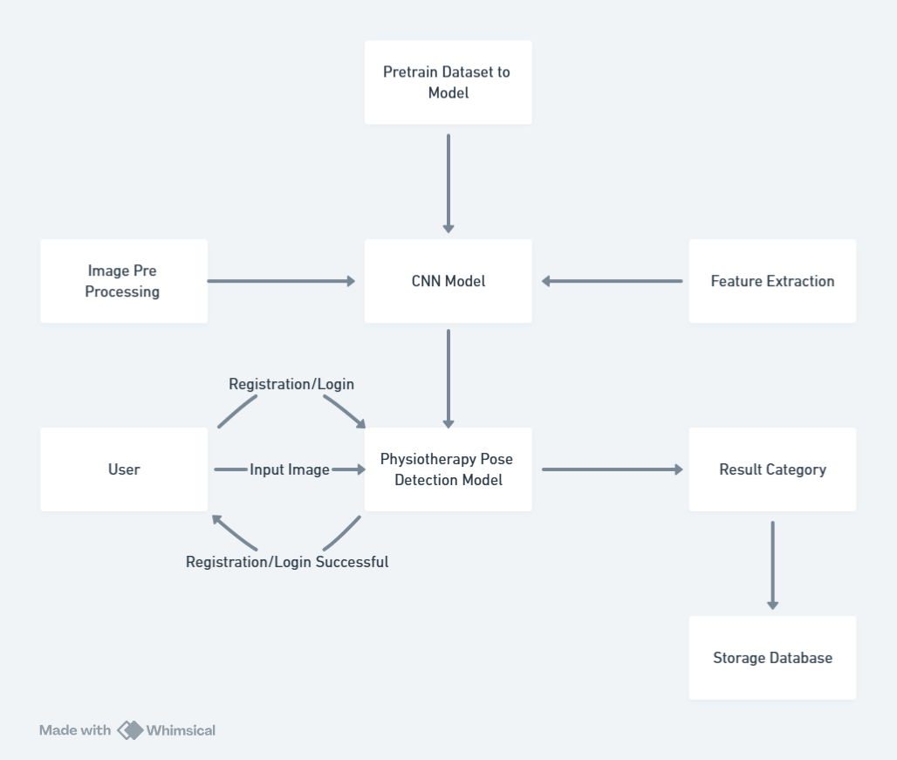
DFD
Level 2

Slide 22
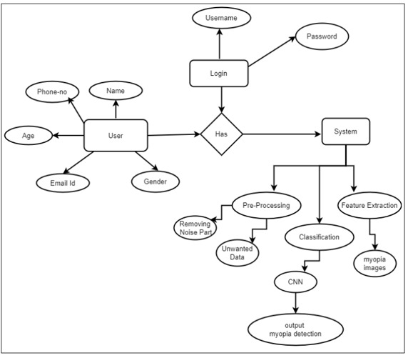
ENTITY RELATIONSHIP DIAGRAM
Pose Images
Pose Detection

Slide 23
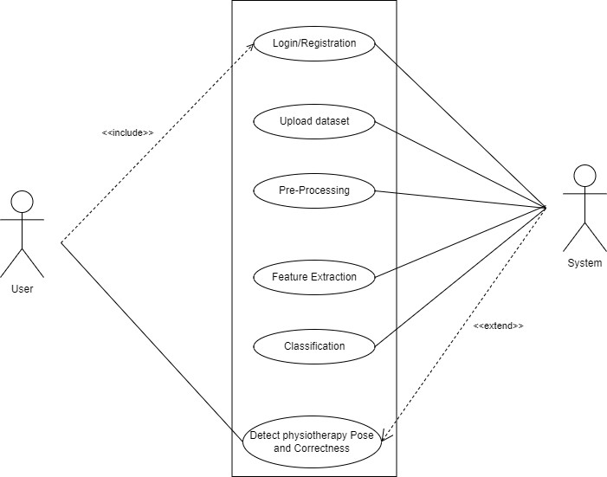
USE CASE DIAGRAM

Slide 24
SYSTEM IMPLEMENTATION
1. Main Algorithms Used:
Pose Detection:
OpenPose or similar model for detecting body landmarks (e.g., joints).
Classification Algorithm:
Logistic Regression (LR) for classifying pose correctness based on joint angles.
Random Forest/Gradient Boosting (optional) for handling noise and complex patterns.
2. Model Information:
Pose Recognition Model:
Uses machine learning to classify physiotherapy poses in real-time.
Trained on labeled data for correct/incorrect pose prediction.
Training:
Model trained using labeled datasets and evaluated with cross-validation.
3. Dataset Used:
Physiotherapy Pose Dataset:
Labeled images or videos with body landmarks for different physiotherapy poses.
Data Points:
Body key points (e.g., elbows, knees) and pose labels (correct/incorrect).
Preprocessing:
Normalization, alignment, and noise reduction before model training.
ㅤㅤㅤ

Slide 25
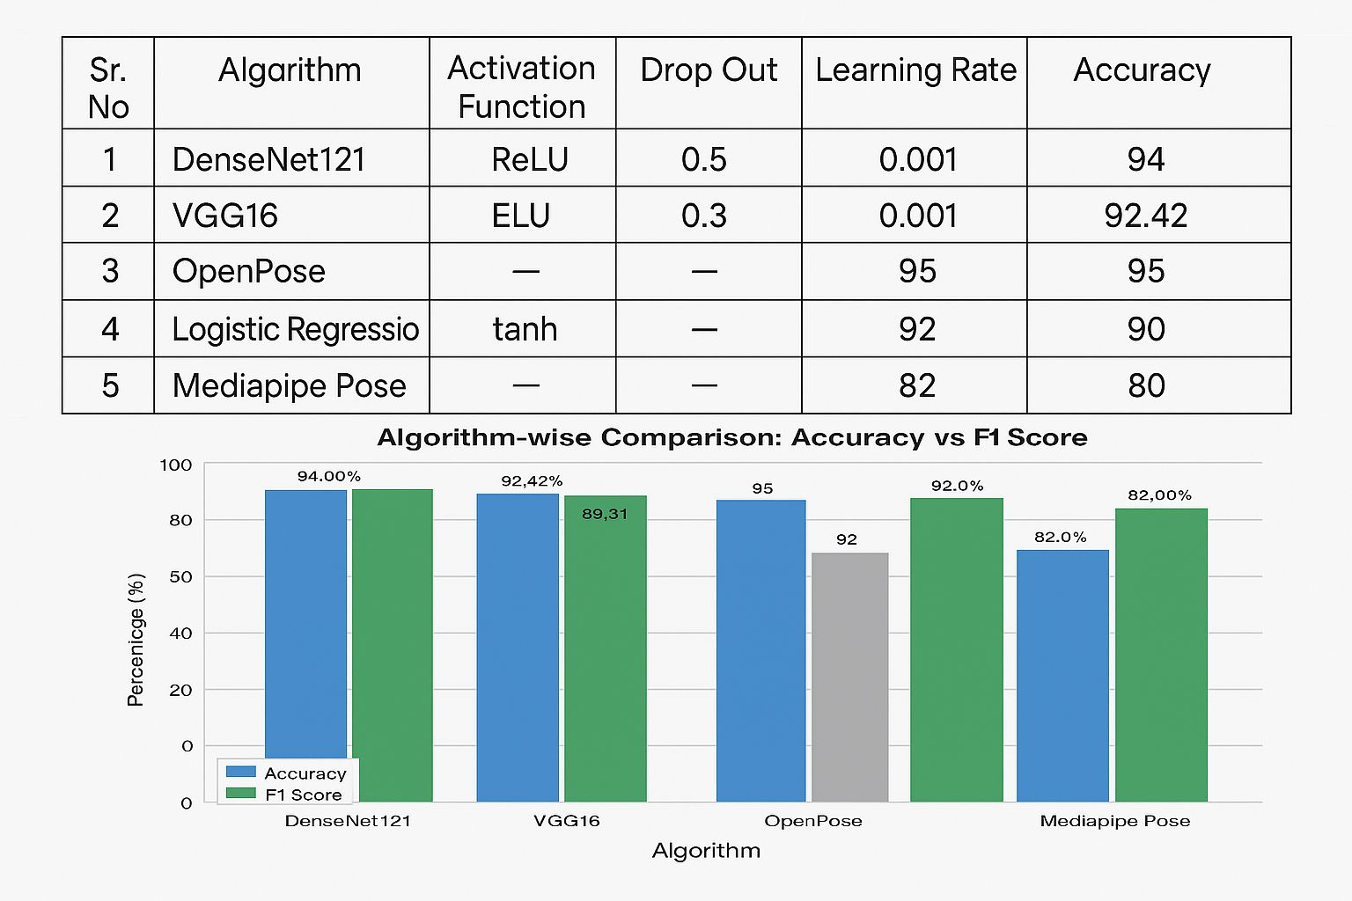

Slide 26
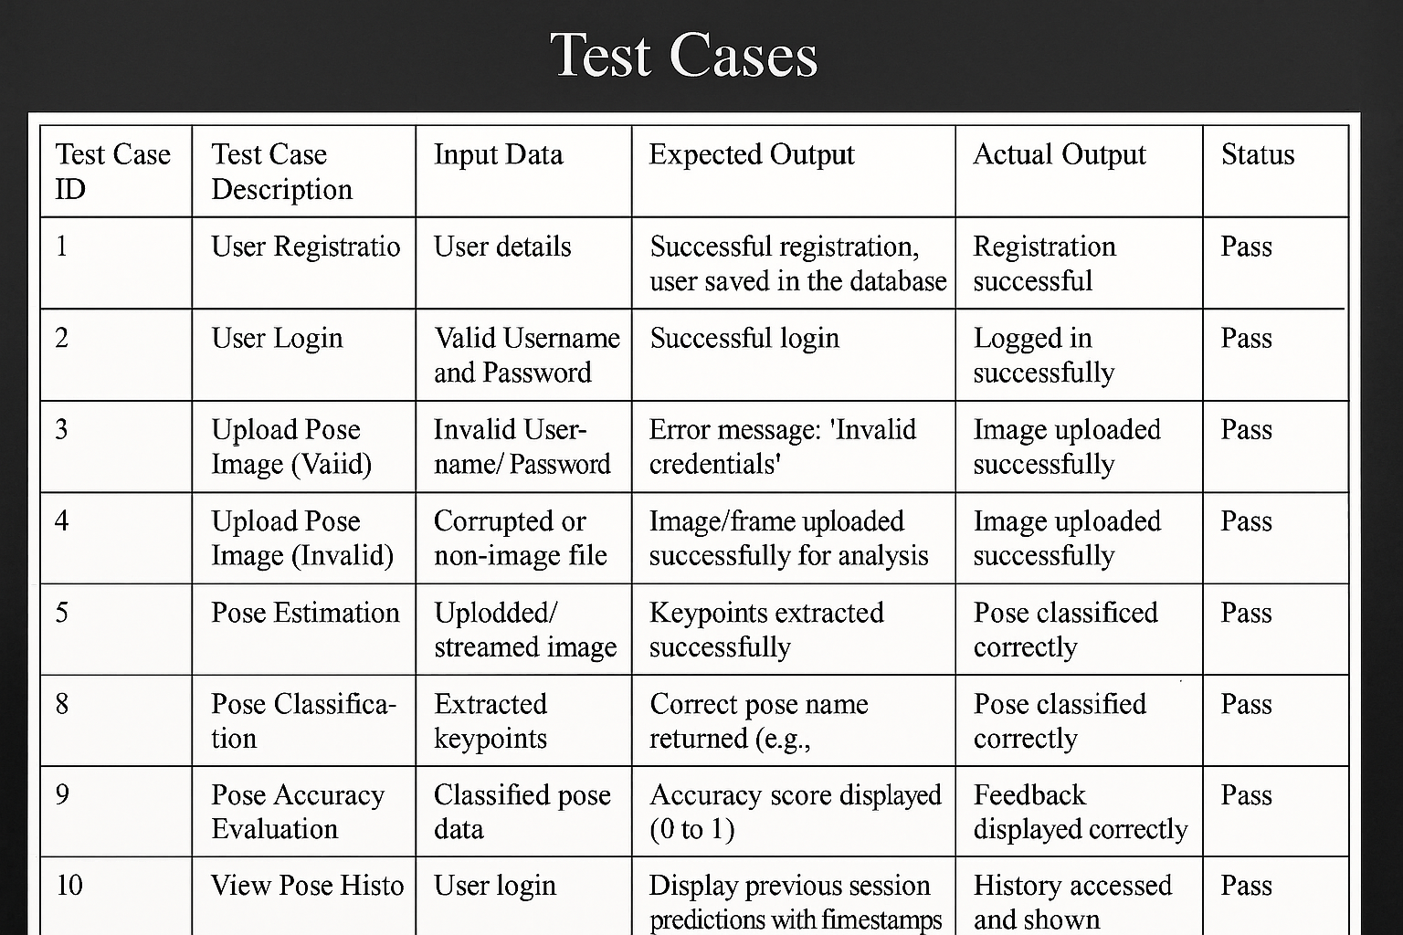
Test Cases

Slide 27
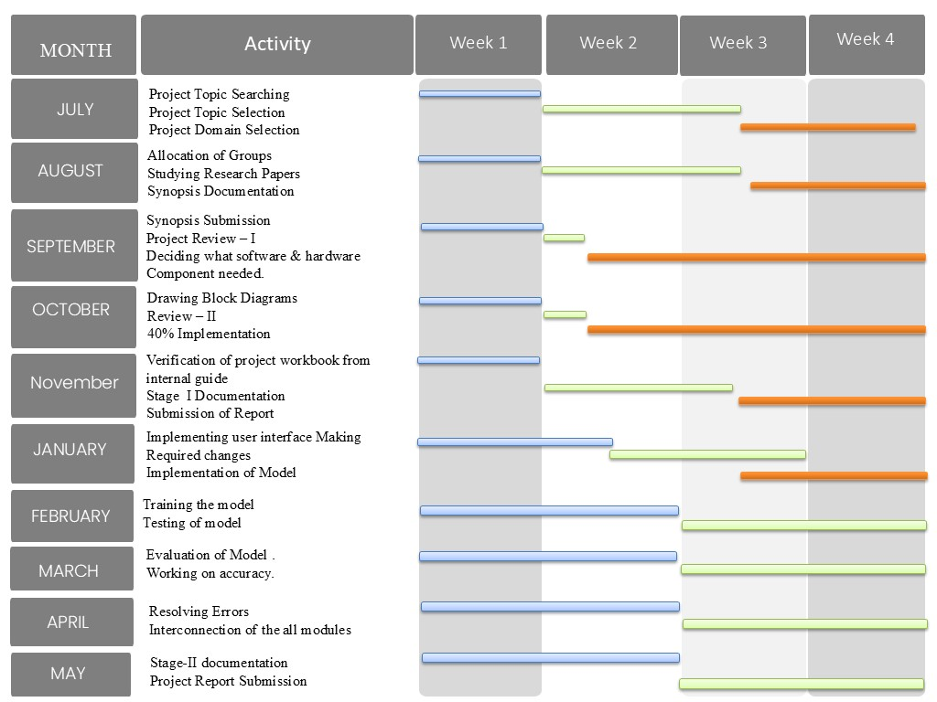
PROJECT PLAN

Slide 28
MODULE
Video/Image Upload: Allows users to upload or capture videos/images of physiotherapy exercises, with validations for file format and size.
Pose Preprocessing: Enhances video/image quality through techniques like background removal, stabilization, and noise reduction.
Pose Extraction: Identifies key body landmarks (e.g., joint positions) using pose estimation models (e.g., OpenPose or MediaPipe).
Pose Analysis: Analyzes extracted pose information to detect correct or incorrect posture, exercise form, and range of motion.
Classification of Exercise Performance: Classifies poses into categories such as correct, partially correct, or incorrect based on predefined physiotherapy guidelines.
Result Display: Displays feedback on exercise performance, with visual cues on errors, confidence and accuracy scores.
ㅤㅤㅤ

Slide 29
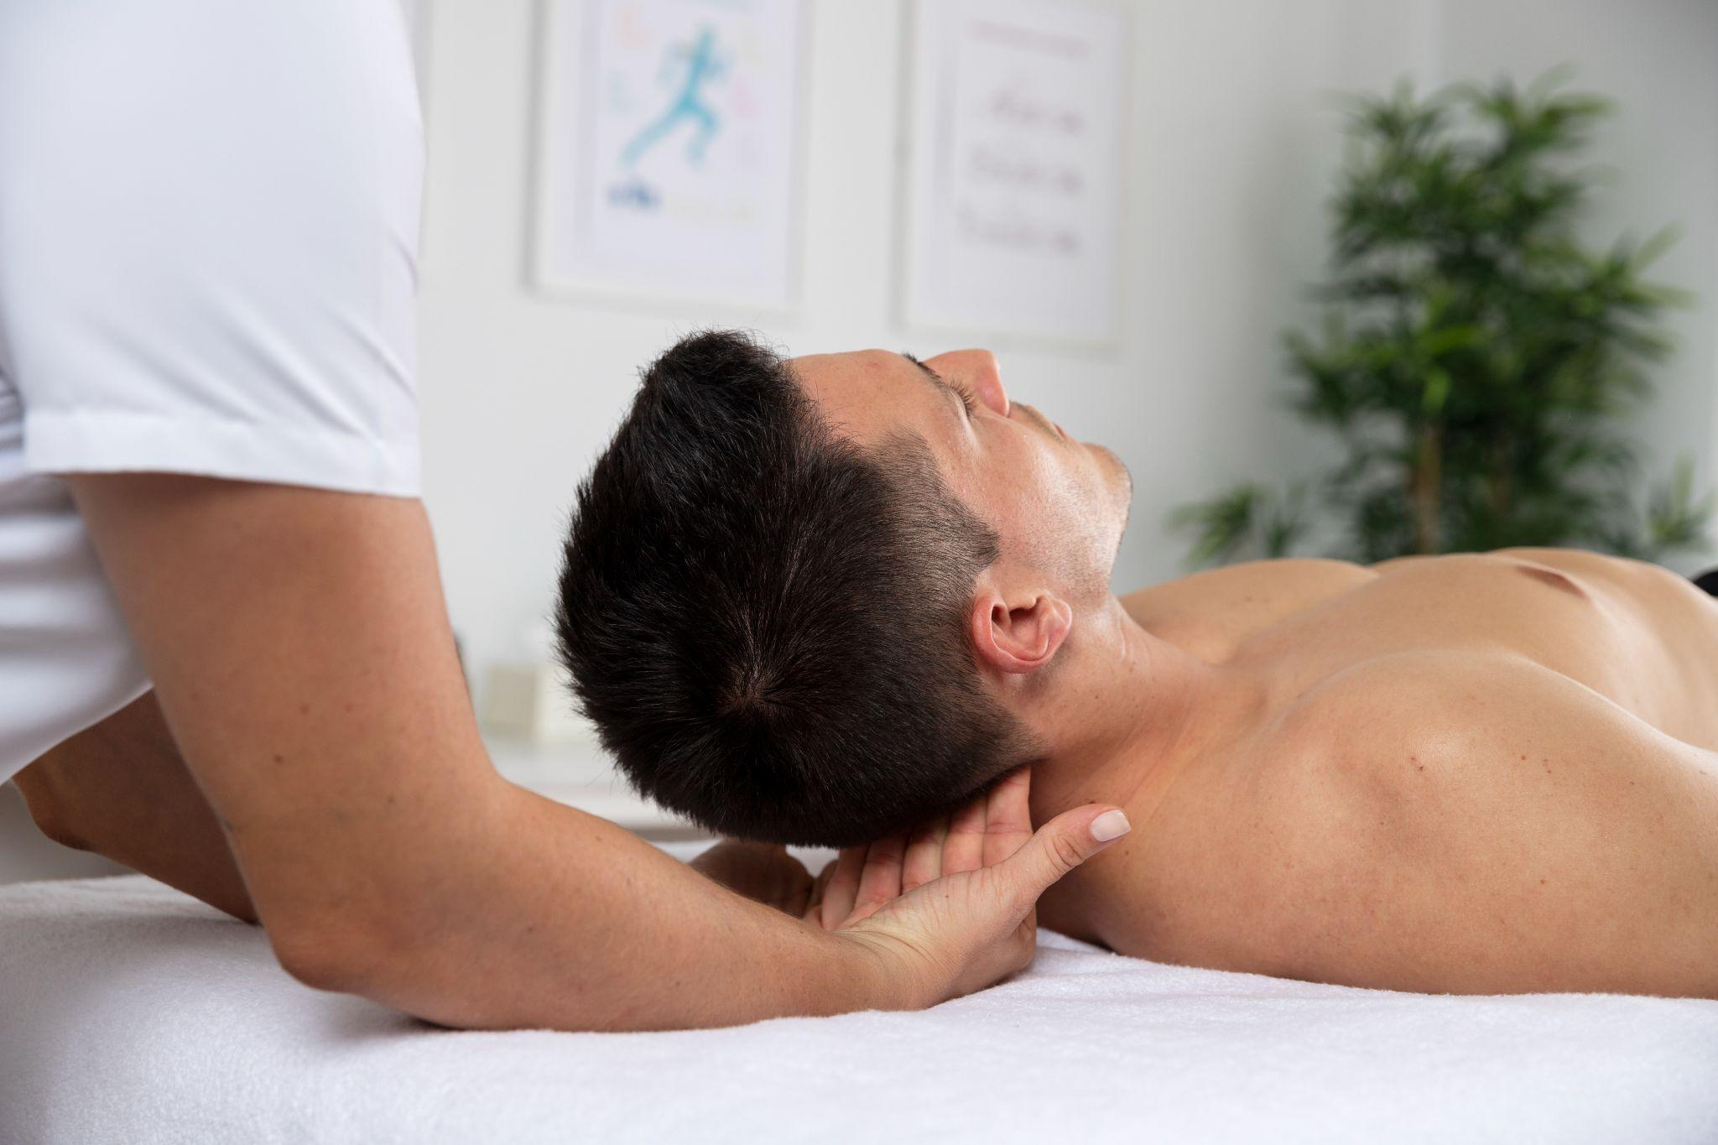
CONCLUSION
We will propose physiotherapy posture recognition and correction in the proposed system. The system evaluates a learner’s physiotherapy pose by:
Detecting the pose,
Measuring the difference in body angles between an instructor’s and a user’s stance,
Identifying the erroneous part between the learner and the teacher, and
Categorising the pose into four levels based on the average angle difference.

Slide 30
REFRENCES
https://arxiv.org/abs/2201.07594
https://arxiv.org/abs/2004.10362
https://ieeexplore.ieee.org/abstract/document/8692300
https://dspace.mit.edu/handle/1721.1/128342
https://ieeexplore.ieee.org/document/8707064
https://ieeexplore.ieee.org/document/9211145

Slide 31
THANK YOU!
ㅤㅤㅤ

